Slide 1

Medical Group
Sp

Slide 2
01
03
Telas
Backlog e Kanban
02
04
Telas wordpress
Briefing
T
🠺
🠺

Slide 3
01
Telas
T
1
🠺
🠺

Slide 4
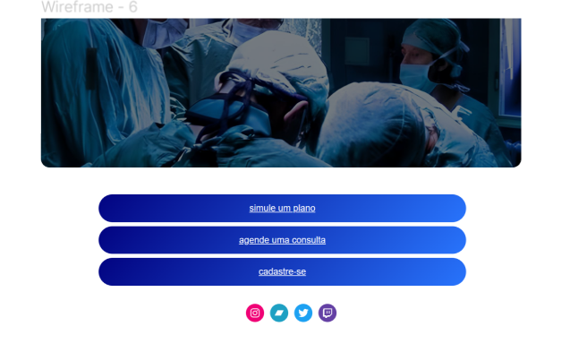
🠺
🠺

Slide 5
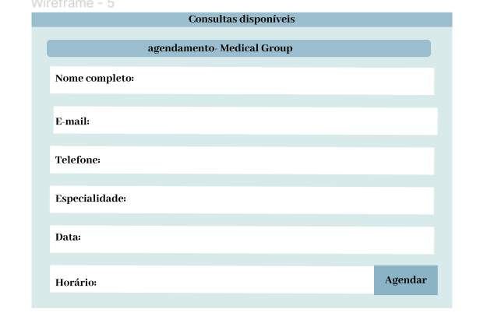
🠺
🠺

Slide 6
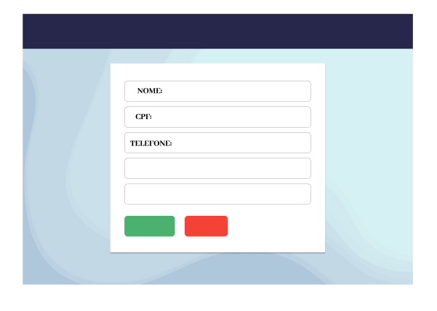
🠺
🠺

Slide 7
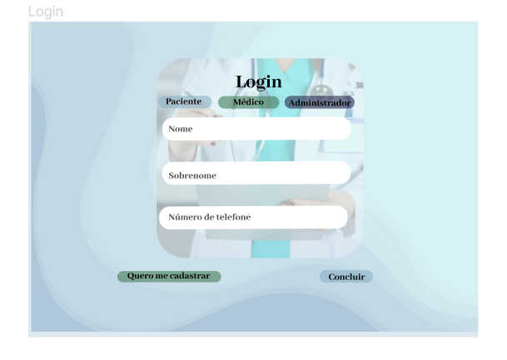
🠺
🠺

Slide 8
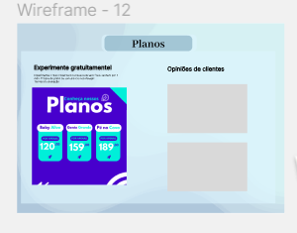
🠺
🠺

Slide 9
02
Telas Wordpress
T
1
🠺
🠺

Slide 10
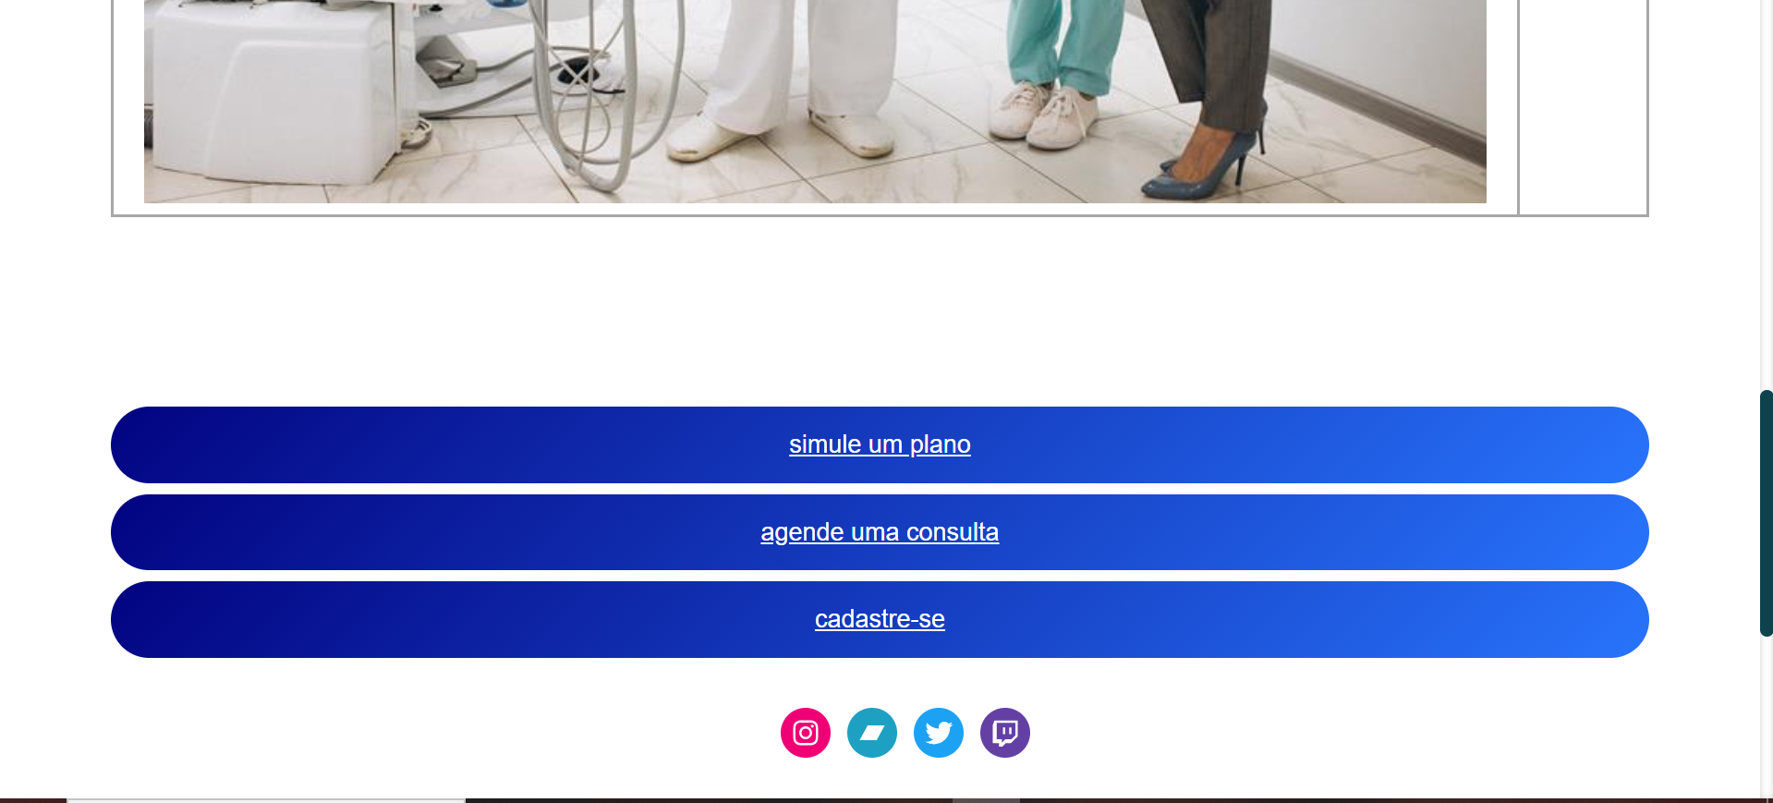
🠺
🠺

Slide 11
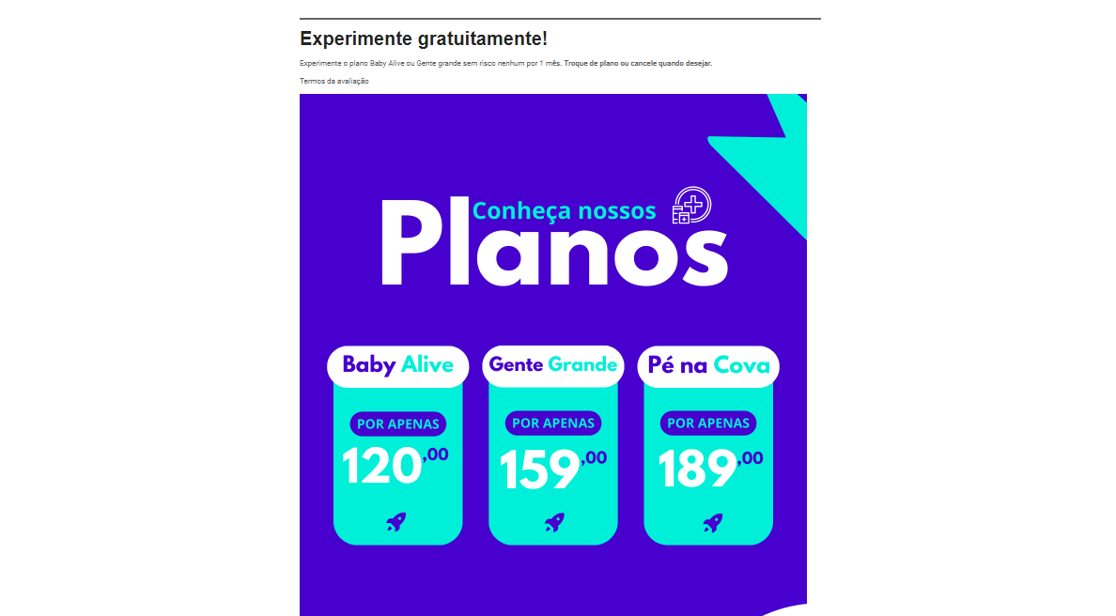
🠺
🠺

Slide 12
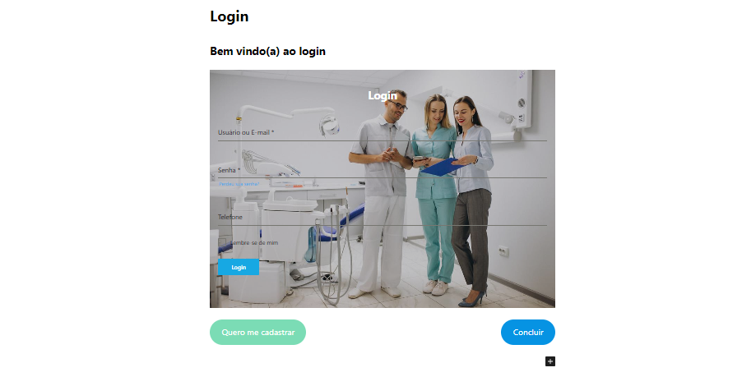
🠺
🠺

Slide 13
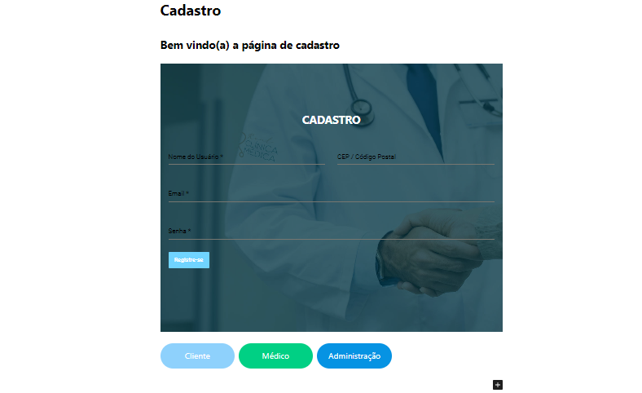
🠺
🠺

Slide 14
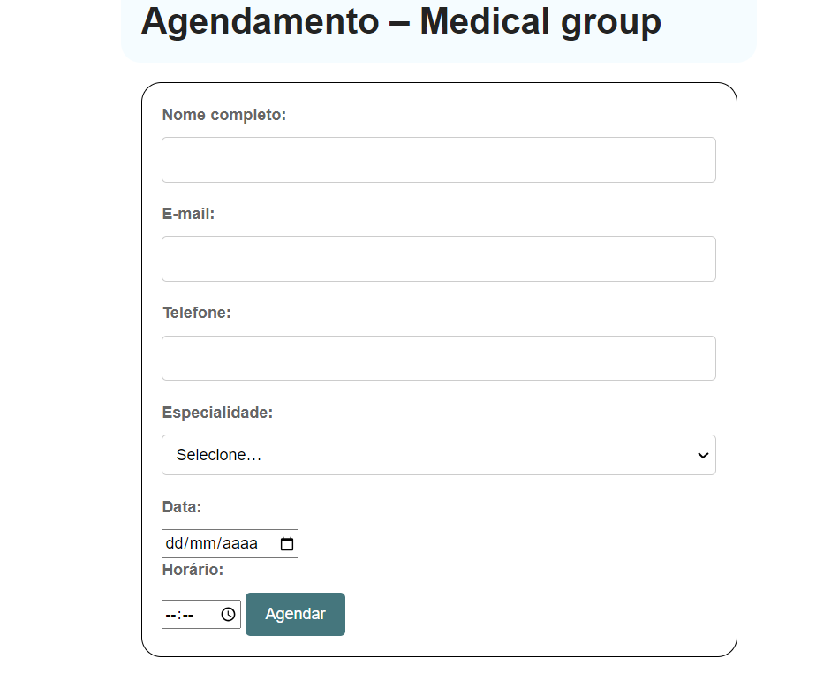
🠺
🠺

Slide 15
03
Backlog e Kanban
T
1
🠺
🠺

Slide 16
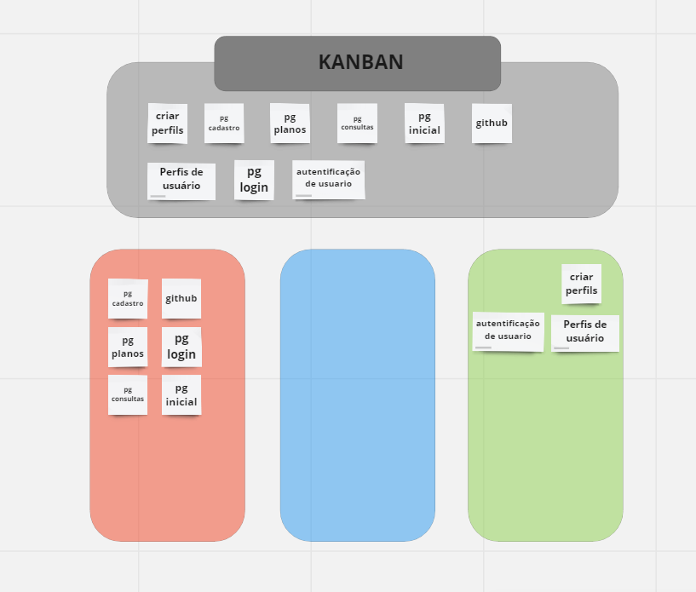
T
1
🠺
🠺

Slide 17
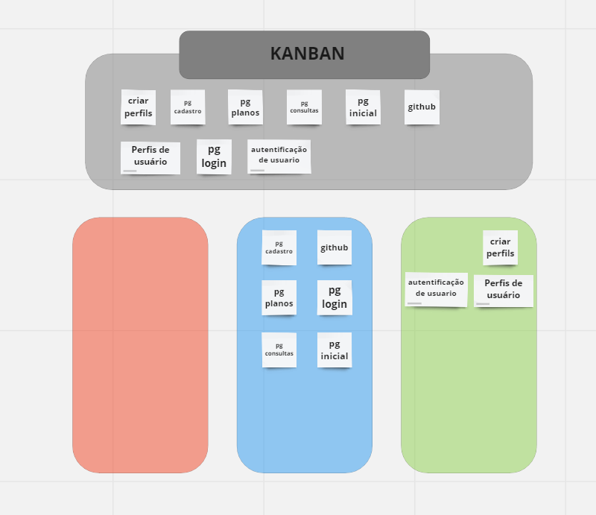
T
1
🠺
🠺

Slide 18
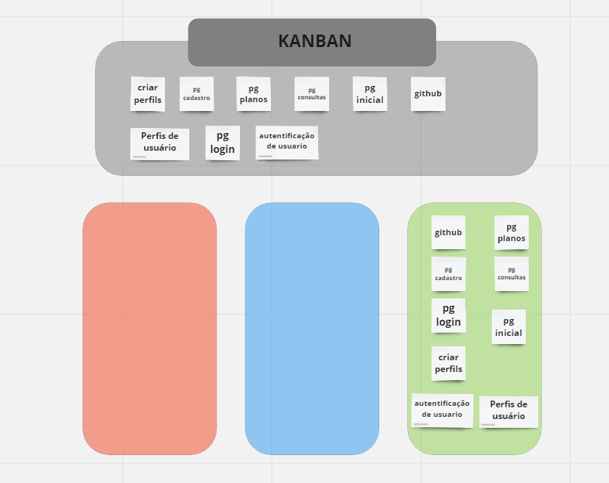
T
1
🠺
🠺

Slide 19
04
Briefing
T
4
🠺
🠺

Slide 20
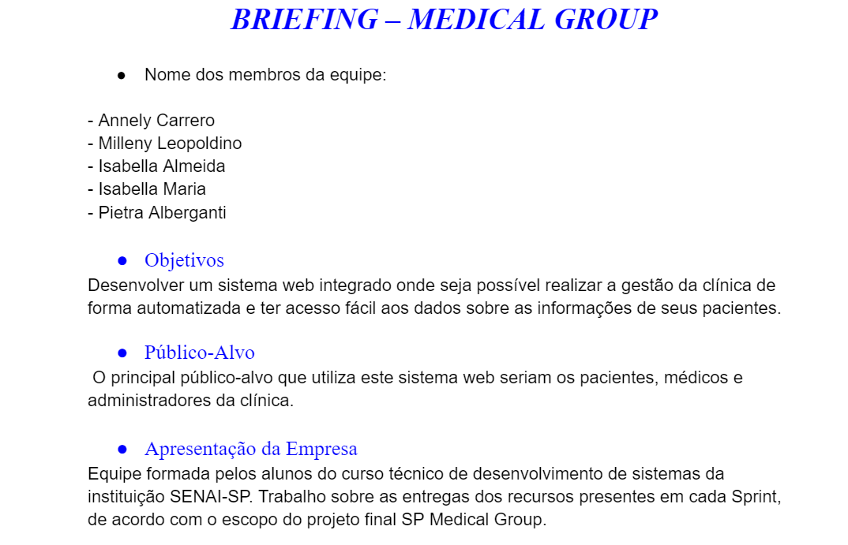

Slide 21
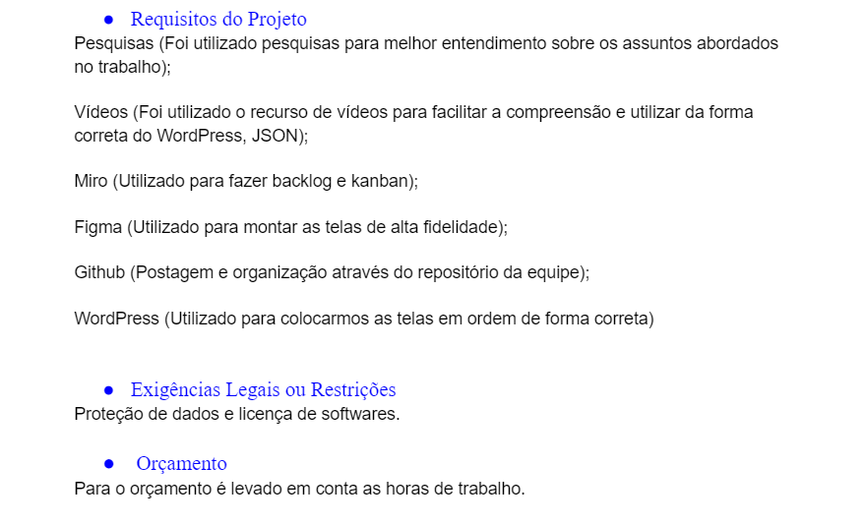

Slide 22
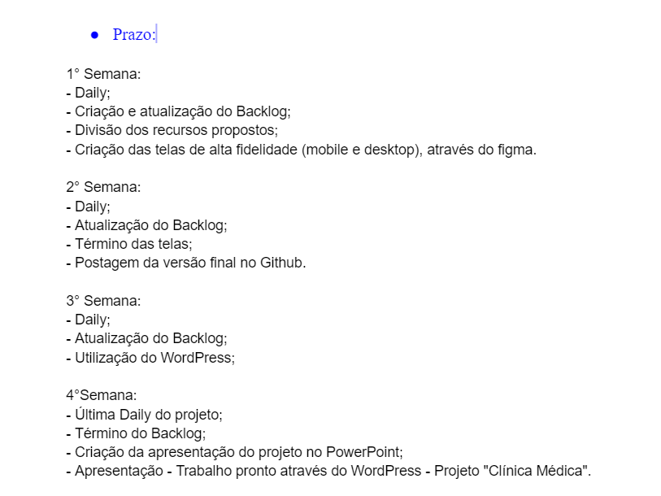

Slide 23
